Slide 1
Integrated development environment (IDE)

Slide 2

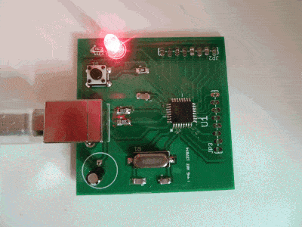
Program Development Flow
High level language
Compiler
Assemblers
Linker
Application (Binary)

Slide 3
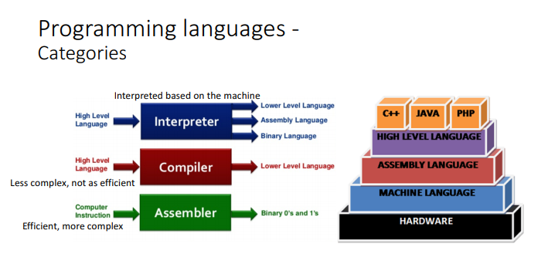
Programming languages -Categories

Slide 4
Integrated development environment (IDE)
An integrated development environment (IDE) is a software suite that consolidates basic tools required to write and test software.
Developers use numerous tools throughout software code creation, building and testing. Development tools often include text editors, code libraries, compilers and test platforms. Without an IDE, a developer must select, deploy, integrate and manage all of these tools separately. An IDE brings many of those development-related tools together as a single framework, application or service. The integrated toolset is designed to simplify software development and can identify and minimize coding mistakes and typos.
Some IDEs are open source, while others are commercial offerings. An IDE can be a standalone application or it can be part of a larger package.

Slide 5
MicroPython IDE
MicroPython is an open-source programming language derived from Python 3 and designed for microcontrollers and embedded systems applications. To write and run MicroPython code we need an IDE to program the Microcontroller.
MicroPython is only a programming language interpreter and does not include an editor. Some MicroPython boards support a web-based code prompt/editor, but with most MicroPython boards you'll write code in your desired text editor and then use small tools to upload and run the code on a board.

Slide 6
MicroPython IDEs
Mu Editor
uPyCraft IDE
Thonny IDE
VS Code + Pymakr extension
PyCharm
microIDE

Slide 7
MicroPython IDE
Thonny is the perfect IDE for Pi if you want to code in Python. It's easy to use and comes with Python 3.7 built-in. If you're new to Python and want to create a basic program with it, Thonny offers a clean simple interface
If you want to do this using Windows or Linux computer, then you should install Thonny Python IDE on your computer.
Thonny IDE: Thonny is a simple IDE for Python with MicroPython support. Intuitive, simple, and easy to use. it’s still a good and intuitive IDE for beginners.

Slide 8
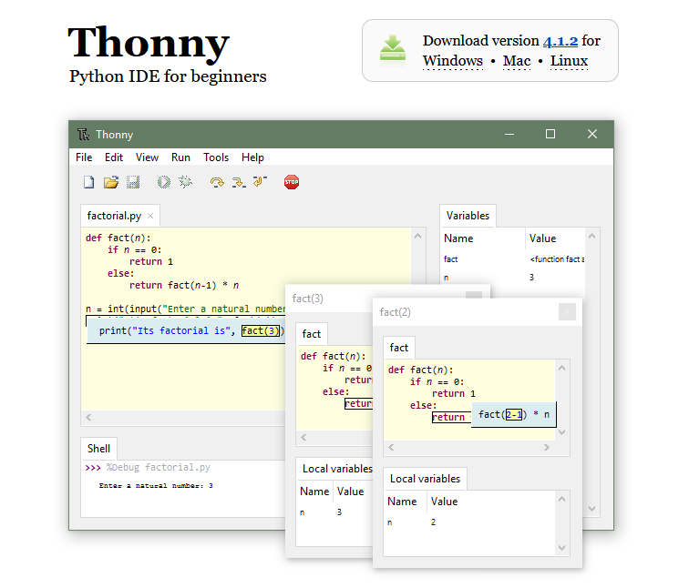
Installing MicroPython IDE
https://thonny.org/

Slide 9
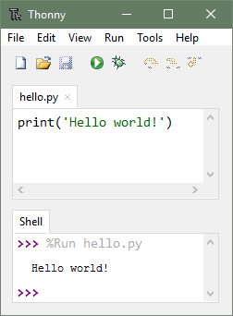
Easy to get started. Thonny comes with Python 3.10 built in, so just one simple installer is needed and you're ready to learn programming. (You can also use a separate Python installation, if necessary.) The initial user interface is stripped of all features that may distract beginners.

Slide 10
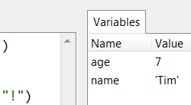
No-hassle variables. Once you're done with hello-worlds, select View → Variables and see how your programs and shell commands affect Python variables.

Slide 11
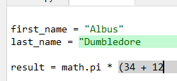
Highlights syntax errors. Unclosed quotes and parentheses are the most common beginners' syntax errors. Thonny's editor makes these easy to spot.

Slide 12
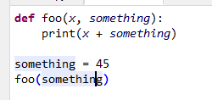
Explains scopes. Highlighting variable occurrences reminds you that the same name doesn't always mean the same variable and helps spotting typos. Local variables are visually distinguished from globals.

Slide 13
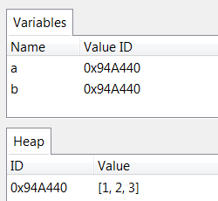
Mode for explaining references. Variables are initially presented according to simplified model (name → value) but you can switch to more realistic model (name → address/id → value).

Slide 14
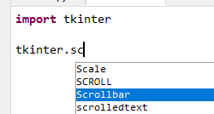
Code completion. Users can explore APIs with the help of code completion.

Slide 15
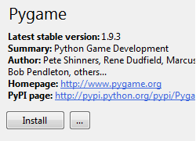
Simple and clean pip GUI. Select Tools → Manage packages for even easier installation of 3rd party packages.

